Slide 1
Ruby Training: Getting to Know Ruby and RubyMine
Matthew Eakin, Manager
Managed Testing Practice
Sogeti, USA
Matthew.Eakin@us.sogeti.com

Slide 2

Course Agenda
RubyMine Settings
Creating the Newbie Project
Creating the newbie.rb file
Variables
Numbers
Operators
Strings
Running Code
Output
Comments in Ruby
Reserved Ruby Words

Slide 3
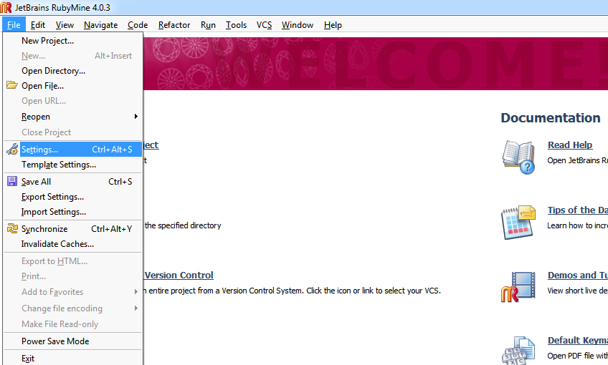
RubyMine Settings
One area you will visit most is the Settings
To get there, goto File ->Settings

Slide 4
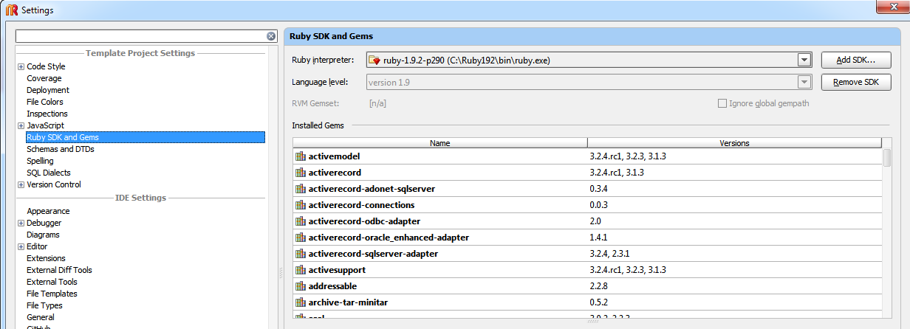
Finding your SDK and gems
In Settings you can find your SDK & gems by going to the Ruby SDK and Gems section
You can remove a Ruby SDK and add one
Here is the Ruby interpreter RubyMine is using
Here is a list of all the gems RubyMine is currently seeing
Note: gems are Ruby SDK-specific

Slide 5
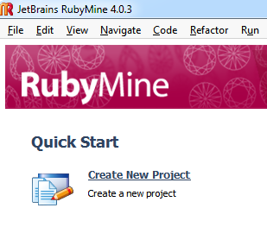
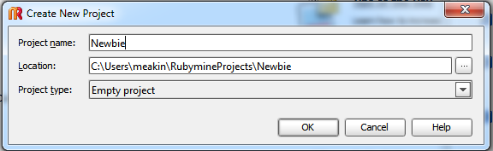
Creating the Newbie Project
From the RubyMine Splash Page click “Create New Project”
Project name = Newbie
Location – use the default location
Project type = Empty Project

Slide 6
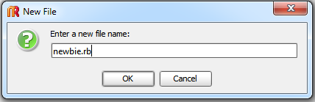
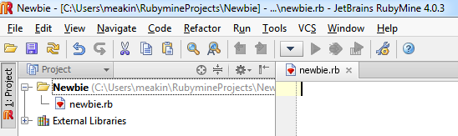
Creating your 1st File
To create a File in RubyMine:
With the Project highlighted, right-click on the project
Select New -> File
Name can be “newbie.rb”
.rb lets the system know it is a Ruby file
Should end up with…

Slide 7
Variables
Definition: any Ruby object that stores a value and assigns a name to that value for reference purposes
Think of variables as a nickname for a value
You can use any word, should be in lower case, can include “_”
An example:
your_cost = wholesale_cost + mark_up + taxes
Variables

Slide 8

Numbers
There are 8 types of numbers in Ruby
Most common are integers (without decimals) and floats (with decimals)
An integer example:
wholesale_cost = 100
mark_up = 15
A float example:
taxes = 5.56
Write This

Slide 9
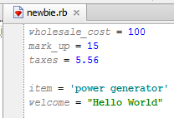
Strings
Definition: Strings are a way to represent text in Ruby
Can be any type of character surrounded by single or double quotes
RubyMine tip: ‘If you use single quotes your code will turn teal’
RubyMine tip: “If you use double quotes your code will turn green”
Examples:
item = ‘power generator’
welcome = “Hello world”
Write This

Slide 10
Ruby naming conventions
Throughout Ruby you will be naming variables, methods, classes, etc..
Names are VERY CASE SENSITIVE in Ruby
Can consist of alphanumeric characters and underscore “_”
Variables and Methods should be all lowercase
Classes should start with a caps but can be mixed after than
Valid Examples:
abc = 1 ThisIsAValidClassName this_is_a_valid_name_123 = 1
ABC = 1

Slide 11


RubyMine (and Ruby) warning messages
Add the following code:
GeneratorCost = 1_500.00
RubyMine will highlight the code
If you put your cursor over the variable you will get an explanation of what is happening
Simply put: you didn’t follow Ruby naming conventions
FIX: generator_cost = 1_500.00
Add the following code:
mater83^&^ = 1_000
RubyMine underlines the problem code in red
If you put your cursor over the error you will get an explanation of what is happening
Simply put: you can’t use “^” in a variable name
FIX: materials = 1_000

Slide 12
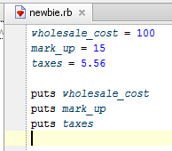
Turning variables from grey to blue
Notice that all of the variables are grey
RubyMine is telling you it is not using them anywhere
Add the following lines of code:
puts wholesale_cost
puts mark_up
puts taxes
What happened to the variables? They should now all be blue
RubyMine lets you know that it is using a variable

Slide 13
Displaying results
To display anything you use the puts method
Syntax:
puts <text to display>
Examples:
puts wholesale_cost
puts mark_up
puts taxes

Slide 14
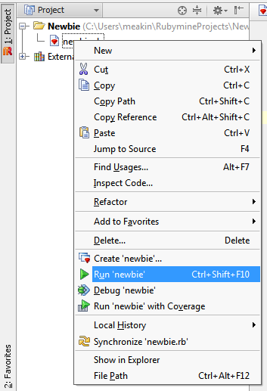
Running your first code
To run a file:
Right-click on the file you wish to run
You should get a drop-down list
Go down to “Run ‘newbie’” and click it

Slide 15
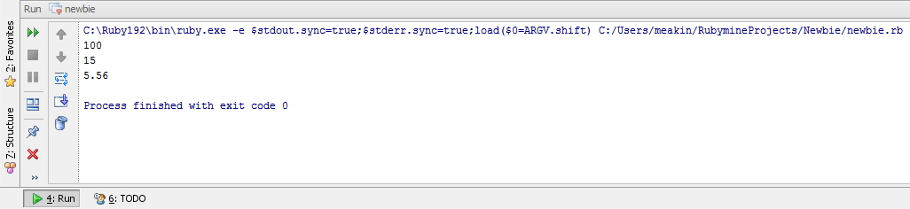
Your first output
At the bottom of the RubyMine screen the “Run” window should appear
The first line is the command line that was executed
Next is your output
The Run tab is at the bottom of the screen

Slide 16
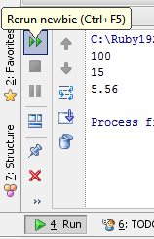
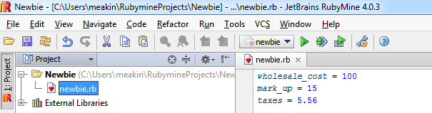
Other ways to run your code
You can re-run your file from the Run tab
click on the double-arrows
You can also now run your file from the options bar at the top of the RubyMine screen
The “strings” file should be listed
The “greeen arrow” should now be enabled
Click the “green arrow”

Slide 17
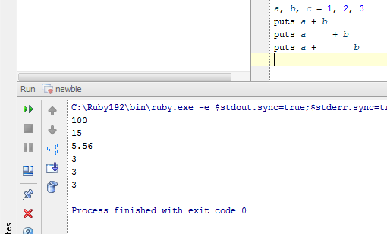
Whitespaces in Ruby
Whitespace characters such as spaces and tabs are generally ignored by Ruby
Code Example: Will get you this output:
a, b, c = 1, 2, 3
puts a + b
puts a + b
puts a + b
Notes:
Have students write this code, but don’t execute yet

Slide 18
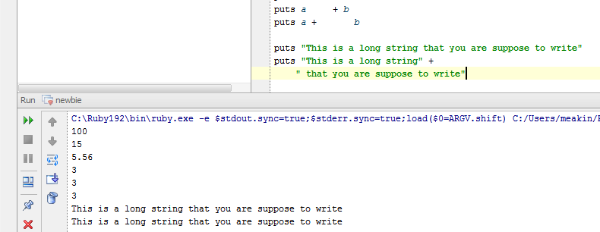
Line Endings in Ruby
Ruby does not need line endings
As you have already seen in previous examples
You can use “+” to continue a line if your display is too long.
Code Example:
puts “This is a long string that you are suppose to write”
puts “This is a long string” +
“ that you are suppose to write”

Slide 19
Comments in Ruby
A comment hides a line from the Ruby interpreter
Comment lines will not be executed
There are 2 main ways to create a comment:
Use the # sign before a line to comment the entire line
Use the “=begin” and the “=end” to comment a block
Examples:
#this is a comment
=begin
This is also a comment
=end

Slide 20
More Commenting
You can also put comments at the end of a line
This can help you document what you are doing
Example:
a, b, c = 1, 2, 3 #here we set the variables
puts a + b #here we add a and b
puts a + b #here we go again
puts a + b #and again
RubyMine Shortcut key: ctrl + “/”
Put the cursor on any line and hit “ctrl + /”

Slide 21
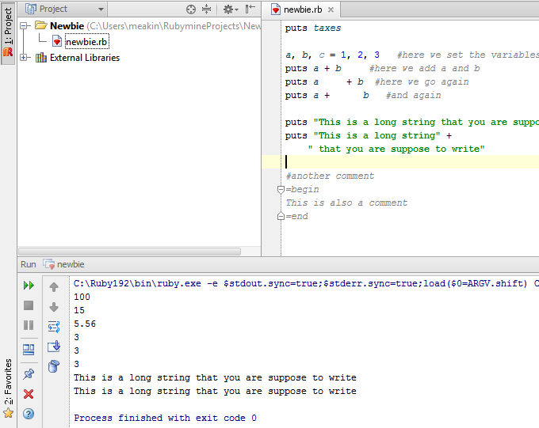
Ruby Comments code examples
Update your Code:
a, b, c = 1, 2, 3 #here we set the variables
puts a + b #here we add a and b
puts a + b #here we go again
puts a + b #and again
And write this new Code:
#another comment
=begin
This is also a comment
=end
If you did your comments correct your output should not have changed
Notes:
Have students write this code, but don’t execute yet

Slide 22
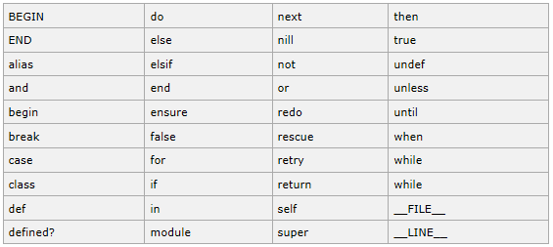
Reserved Words
These are words you cannot use as constant or variable names

Slide 23
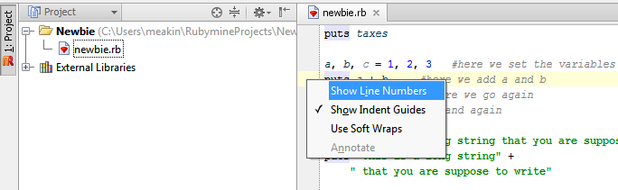
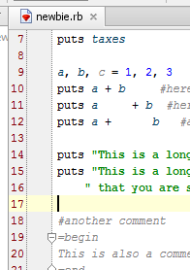
Adding line numbers
To add line numbers simply right-click on the bar to the left of your pallet
Select “Show Line Numbers”
You should now see line numbers

Slide 24
Thank you

